Slide 1
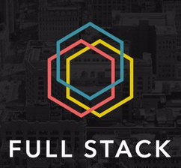
BCDV1006 - Session 3.1.1
Intro to Full Stack Web Development

Slide 2

Professor
Senior UI/Full Stack Developer
14 Years experience building web applications
Specialization in Microsoft .NET and JavaScript Frameworks
2018/2020 Professor - COM3123/COM3133
2020 Professor - Block Chain FS III & IV
https://www.linkedin.com/in/mike-denton-1988597/

Slide 3


Remote Session Structure
We will use a block schedule for the online class session. New learning the first block and then alternating between “hands on” work and lecture.
A short Quiz will be given at the end to help with retention of the topics covered.
6-6:45 pm
Lecture
6:45-7:30 pm Lab Work
7:30-8:15 pm
Lecture/Demo
8:15-9 pm Lab Work
9-9:30 pm Quiz/Questions

Slide 4
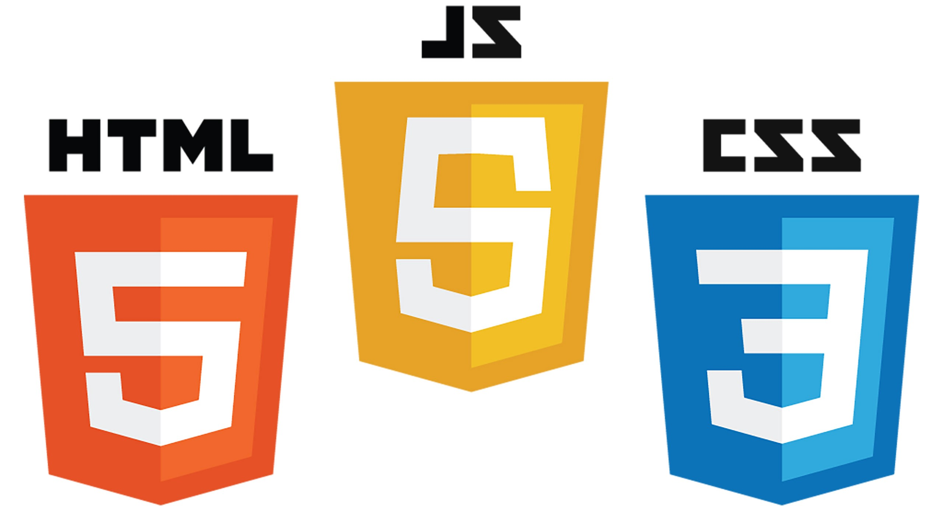


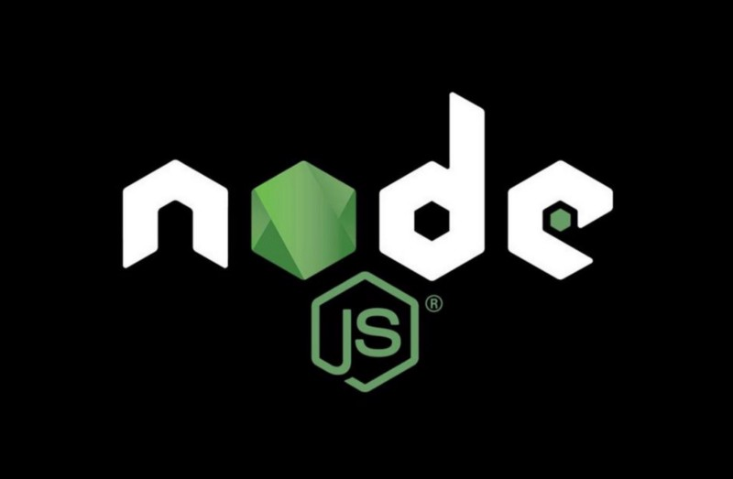
Full Stack I - IV
Full Stack Dev I
Full Stack Dev II
Full Stack Dev III
Full Stack Dev IV

Slide 5
Topics
Technology Stack vs Application Stack
What is Full Stack?
MERN Stack

Slide 6
Technology Stack

Slide 7
What is a Stack?
A “stack” refers to any combination of programming languages and technologies or a combination of software products.
Technically there are two types of development stacks:
Technology stack
Application stack.

Slide 8
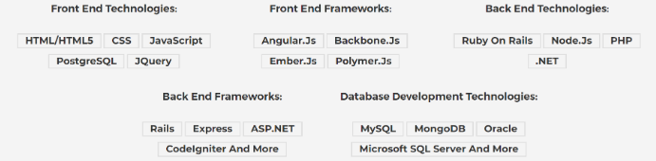
What is a Technology Stack?
In simple terms, the technology stack is a more cross-disciplinary term in any software development process.

Slide 9
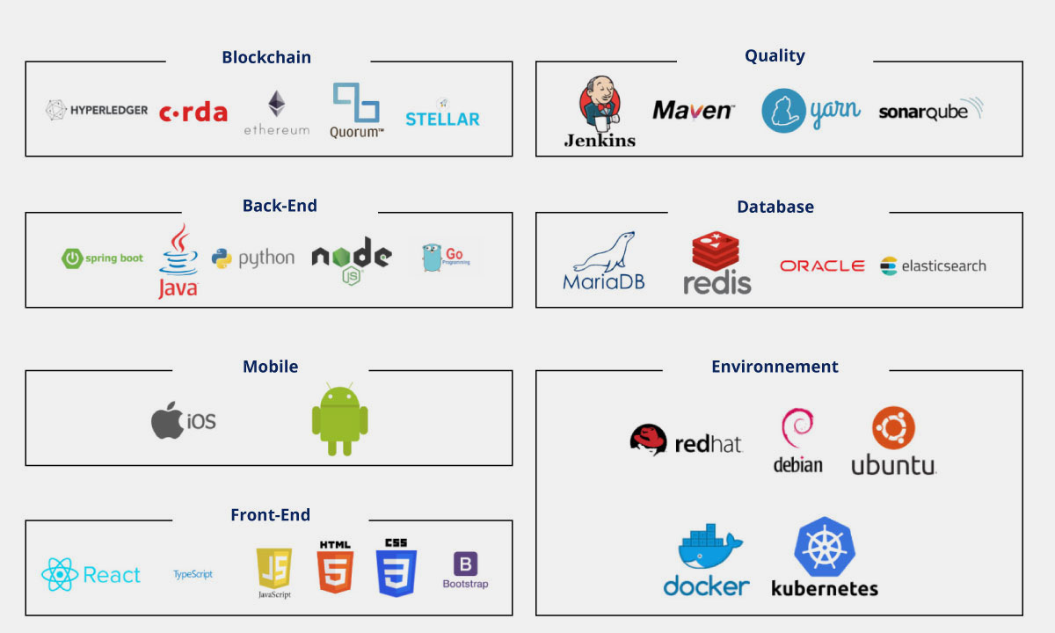

Slide 10
Web Development

Slide 11
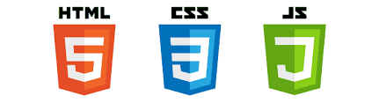
What is a Web Developer
A web developer is at heart an interactive artist. They’re someone driven by a deep desire to create things. A web developer’s canvas is a user’s web browser.
A web developer’s job is to use the basic building blocks of the web (like HTML, CSS and JavaScript) to create something complex like a webpage.
It is also the web developer’s job to diagnose problems in a website’s functionality, to understand how something works by reading the code behind it, and to make changes to fix any issues.

Slide 12
Types of Web Developer
There are different types of web developers who focus on different areas. These include:
Frontend developers: Frontend developers implement web page designs using HTML and CSS. They make sure the website looks pretty on different devices, and that the forms and buttons work.
Backend developers: Backend developers create the backbone of the web application. They write code logic that handles a user’s input (for example, what should happen when you click the signup button after filling in a form).
Full stack developers: Full stack developers do bits of both backend and frontend. Depending on the problem at hand, they can switch cape 🦸‍♀️🦸‍♂️ and move stacks.

Slide 13
Full Stack

Slide 14
Full Stack Developer
Skilled developers come from various streams; to be specific, there is Frontend, Backend, Database, Mobile App
Generalization and Specification? Full Stack developers are seen as generalist, who are 'Jack of all trades' and 'Master of none'
Companies are now rigorously trying to hire full stack developers, who can build the complete web or app from scratch, without any discontinuation in the process.

Slide 15
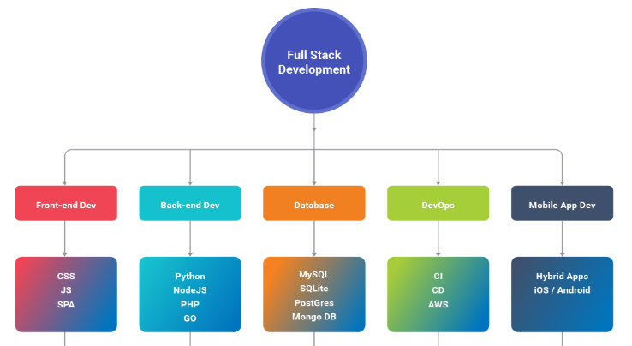

Slide 16
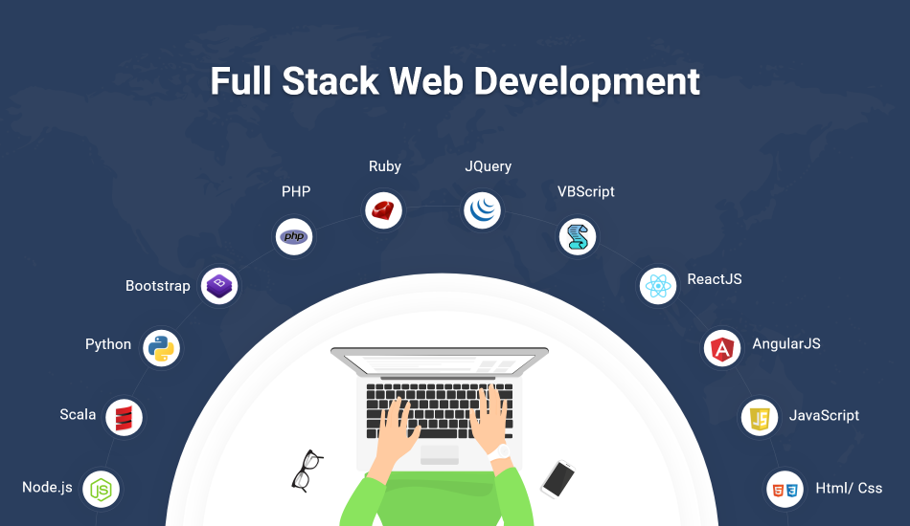

Slide 17
Benefits of Full Stack Developer
Knowledge of both front-end and backend technologies.
Can easily take charge of Project Responsibility
Cost-effective for Company to hire because of the versatility
Full stack development is one of the most in-demand jobs in the past years.
This wasn’t always the case, in the 1970’s programming and development wasn’t multilayered ie. Assembly, COBOL

Slide 18
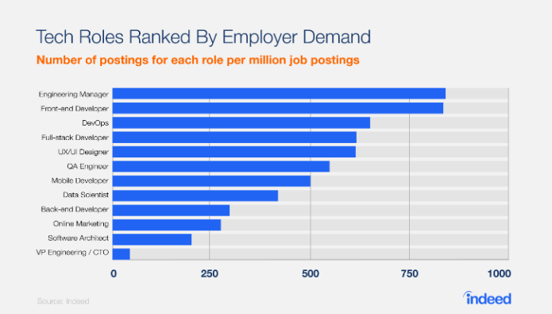

Slide 19
MERN STACK

Slide 20
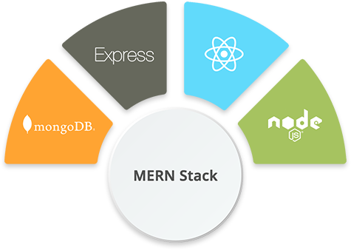
MERN Stack
MERN Stack comprises of the following technologies. MongoDb, Express, React, Node.js

Slide 21
Benefits of MERN Stack
The main advantage for developers using the MERN stack is that every line of code is written in JavaScript.
This is a programming language that's used everywhere, on all layers, both for client-side code and server-side code.
With one language across tiers, there's no need for context switching. All developers “speak” the same language.

Slide 22
Developer Tools

Slide 23
What tools do the professionals use?
A computer. Maybe that sounds obvious to some people, but some of you are reading this article on your phone or a library computer. For serious web development, it's better to invest in a desktop or laptop computer running Windows, macOS or Linux.
A text editor, to write code in. This could be a text editor (e.g. Visual Studio Code, Notepad++, Sublime Text, Atom, GNU Emacs, or VIM), or a hybrid editor (e.g. Dreamweaver or WebStorm). Office document editors are not suitable for this use, as they rely on hidden elements that interfere with the rendering engines used by web browsers.
Web browsers, to test code in. Currently, the most-used browsers are Firefox, Chrome, Opera, Safari, Internet Explorer and Microsoft Edge. You should also test how your site performs on mobile devices and on any old browsers your target audience may still be using (such as IE 8–10.)

Slide 24
What tools do the professionals use? (cont..)
A graphics editor, like GIMP, Figma, Paint.NET, Photoshop, or XD, to make images or graphics for your web pages.
A version control system, to manage files on servers, collaborate on a project with a team, share code and assets and avoid editing conflicts. Right now, Git is the most popular version control system along with the GitHub or GitLab hosting service.
An FTP program, used on older web hosting accounts to manage files on servers (Git is increasingly replacing FTP for this purpose). There are loads of (S)FTP programs available including Cyberduck, Fetch and FileZilla.

Slide 25
What tools do the professionals use? (cont..)
An automation system, like Webpack, Grunt, or Gulp to automatically perform repetitive tasks, such as minifying code and running tests.
Libraries, frameworks, etc., to speed up writing common functionality. A library tends to be an existing JavaScript or CSS file that provides ready-rolled functionality for you to make use of in your code. A framework tend to take this idea further, offering a complete system with some custom syntaxes for you to write a web app on top of.

Slide 26
Visual Studio Code

Slide 27

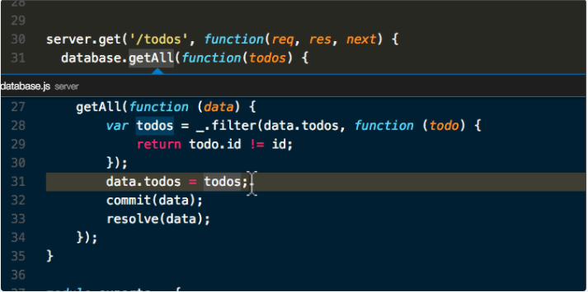
Visual Studio Code
Visual Studio Code is a lightweight but powerful source code editor which runs on your desktop and is available for Windows, macOS and Linux. It comes with built-in support for JavaScript, TypeScript and Node.js and has a rich ecosystem of extensions for other languages (such as C++, C#, Java, Python, PHP, Go) and runtimes (such as .NET and Unity).
Notes:
https://code.visualstudio.com/docs

